Slide 1
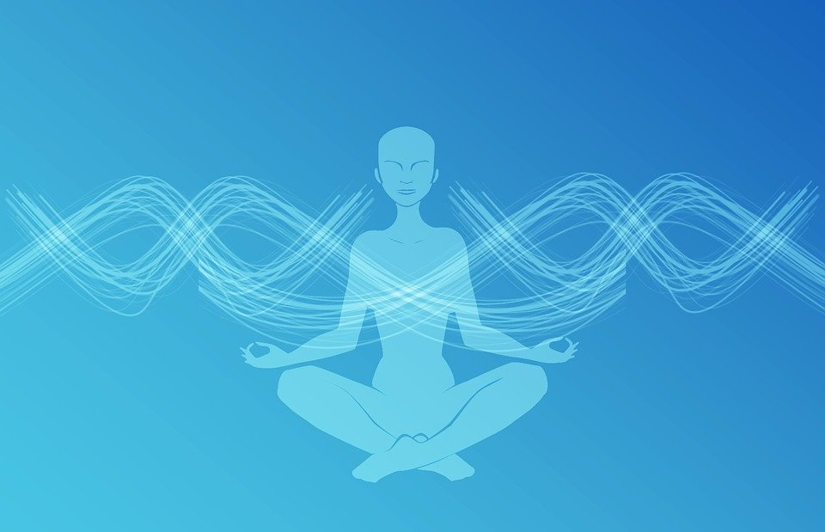
Katichakrasana
Group - 38
Sports and Well-Being
Instructor: Dr Rajlakshmi Guha
Group Members:
Shashish Maurya (18CH10051)
Ujjwal Tiwary (18CH10058)
Isha Sharma (18CH10068)
Anshuman Agrawal (18CH10071)
Sarvottam Kumar Modi (18CH10073)

Slide 2
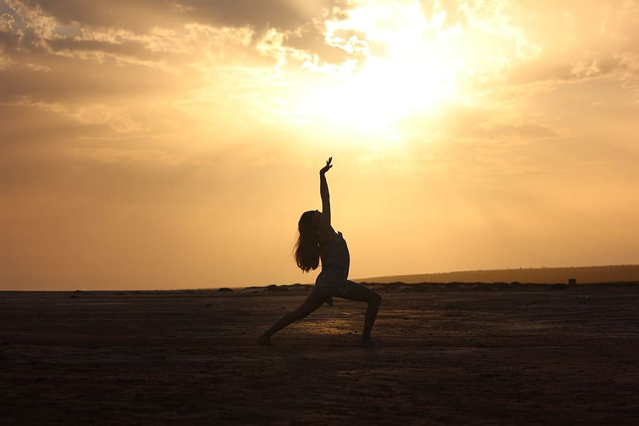
Introduction

Slide 3
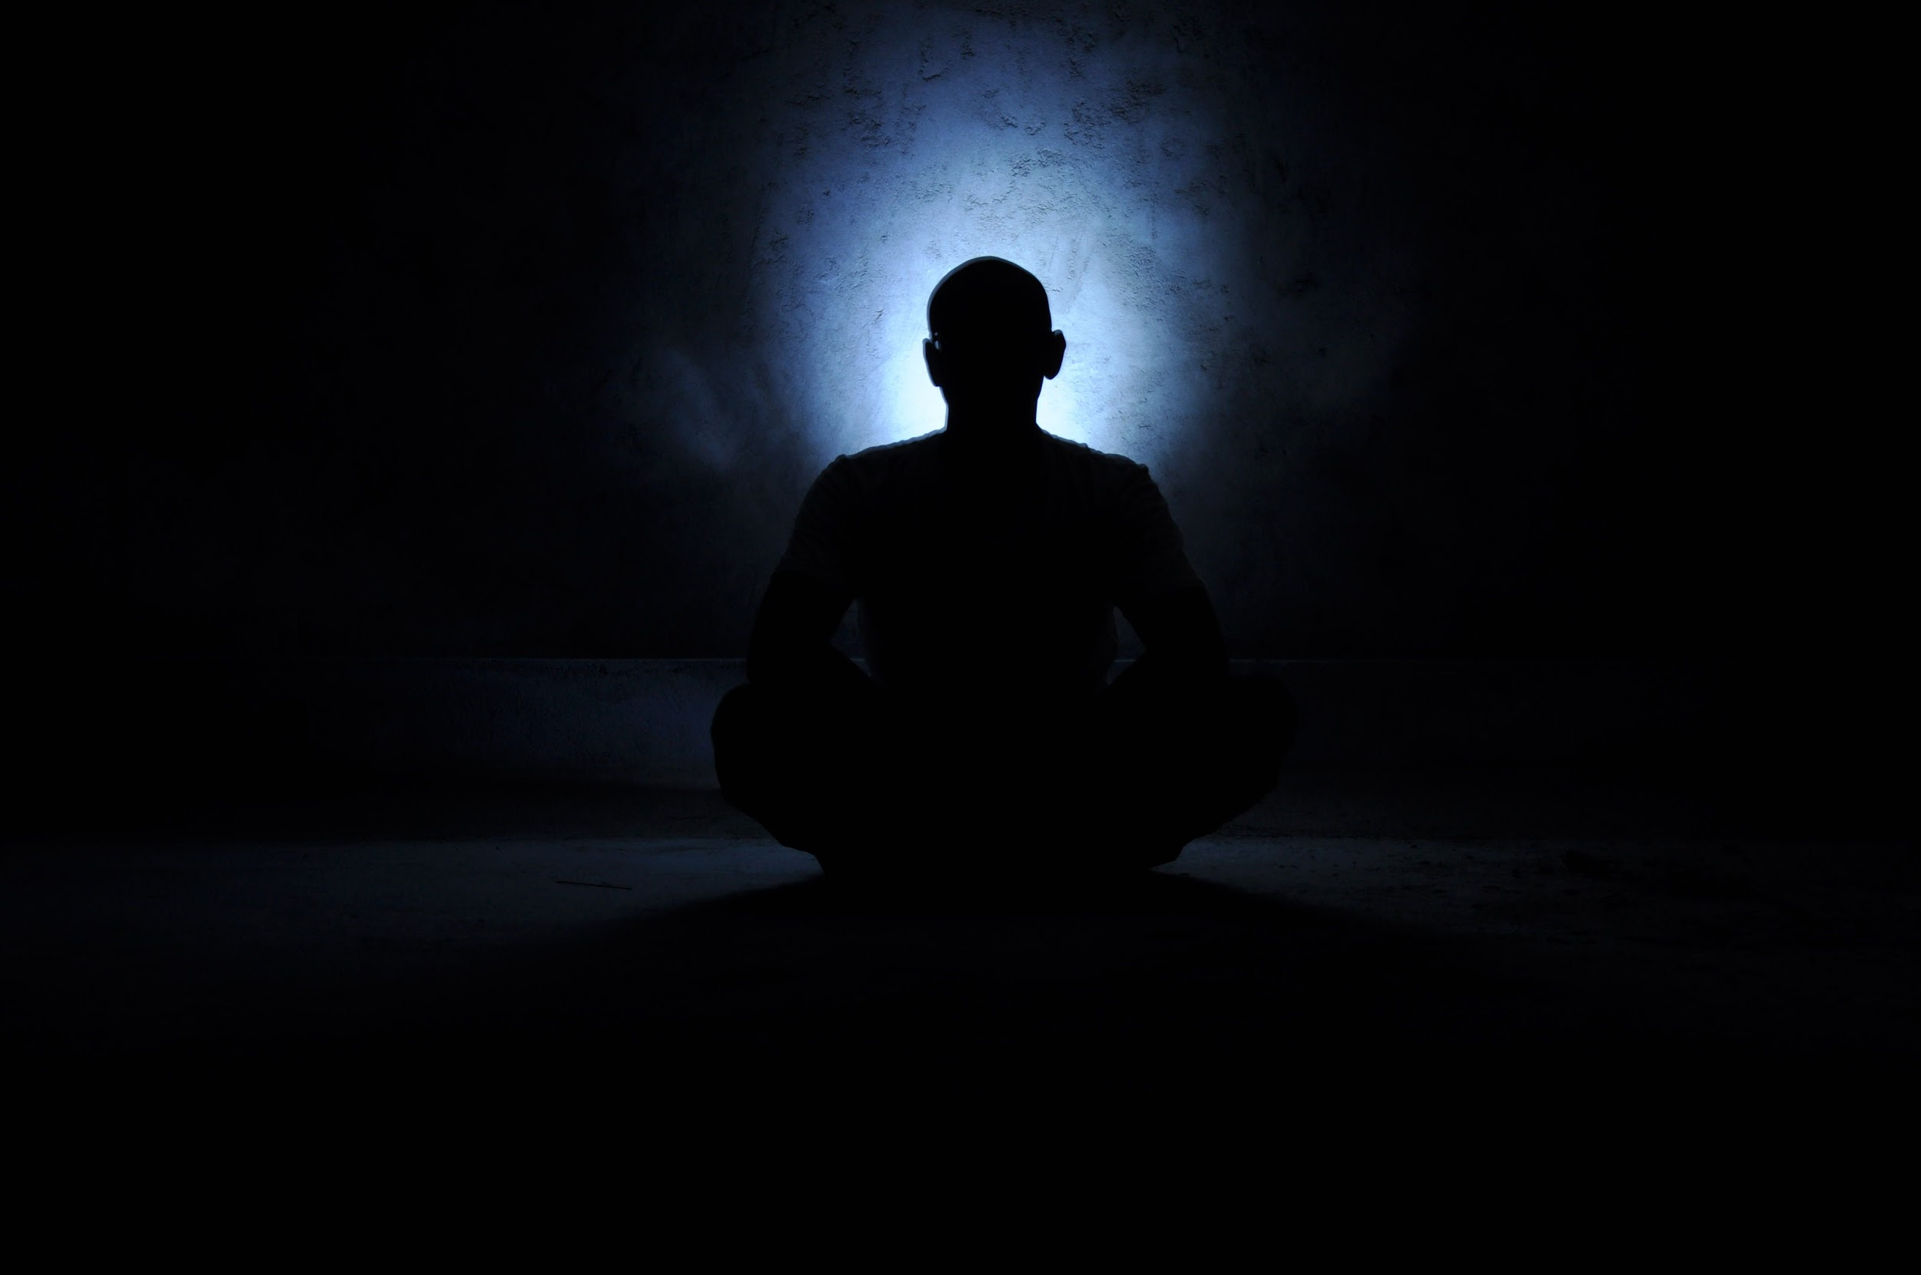
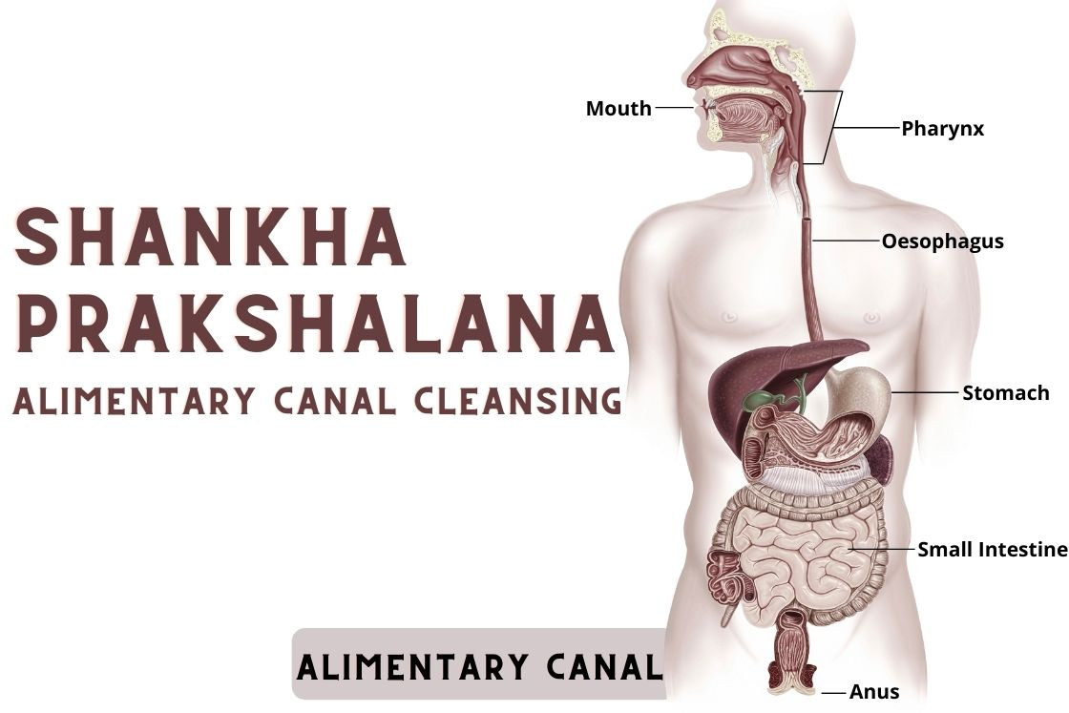
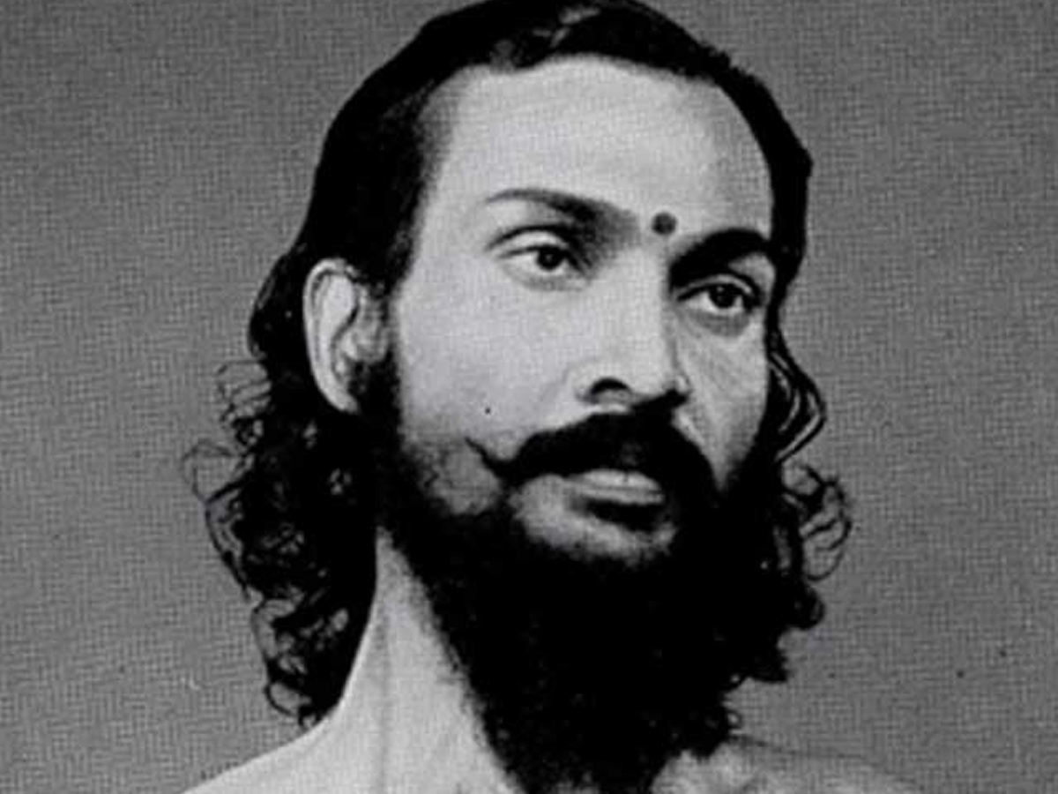
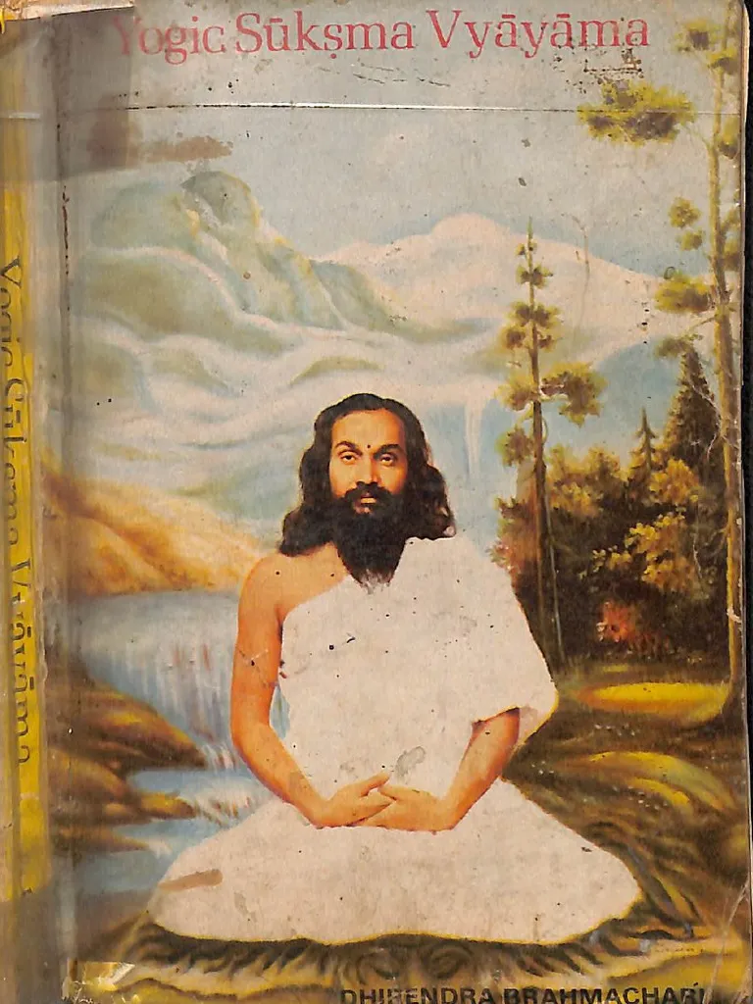
Meaning
Kati - Sanskrit for Waist
Chakra - Sanskrit for Wheel/ Rotation
Asana - Yogic posture
In English: Waist Rotation Pose/ Standing Spinal Twist

Slide 4
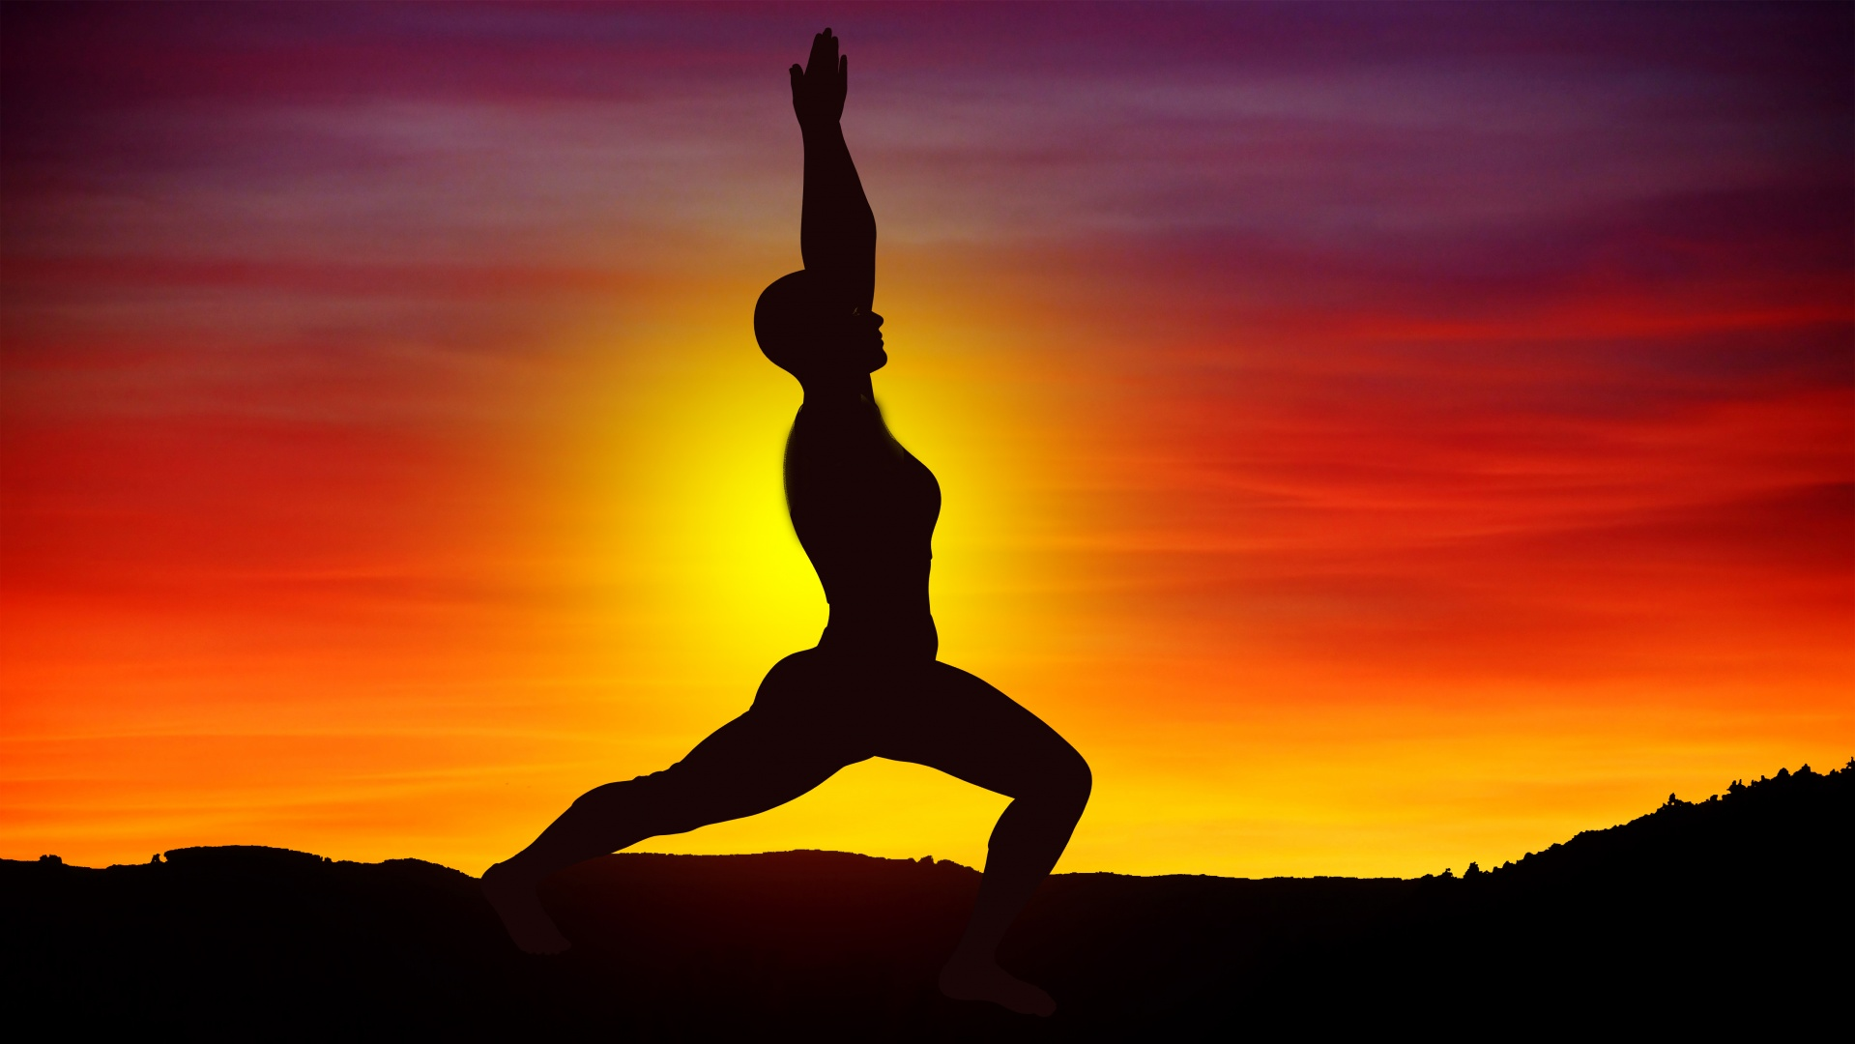
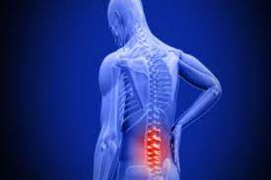

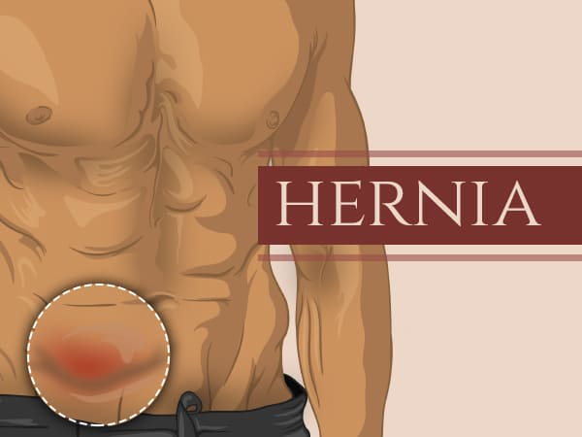

Precautions and Contraindications

Slide 5
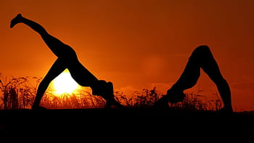
Step-by-Step
Procedure

Slide 6
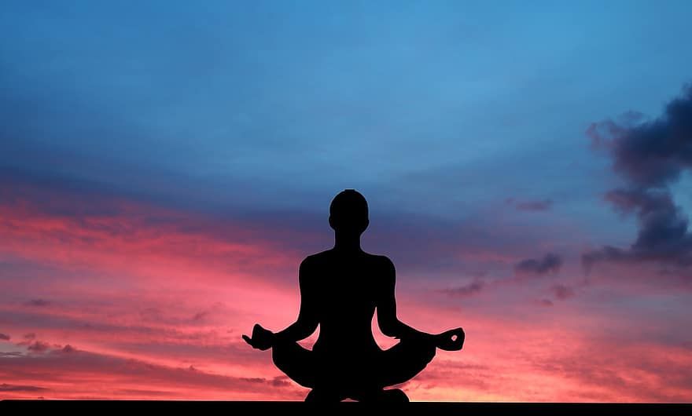
Step 1: Stand up straight with feet firmly on the ground.
Step 2: Inhale + Hands stretched to front with palms facing each other and parallel to ground
Step 3: Exhale + Waist twist towards right while moving arms + Look over shoulder
Step 4: Inhale + Twist back towards centre
Step 5: Repeat 3 towards left
Step 6: Repeat few times. End with exhale + hands down
10-20 cycles
30 seconds per cycle
Checkpoint !!
Arms at shoulder width away from each other

Slide 7
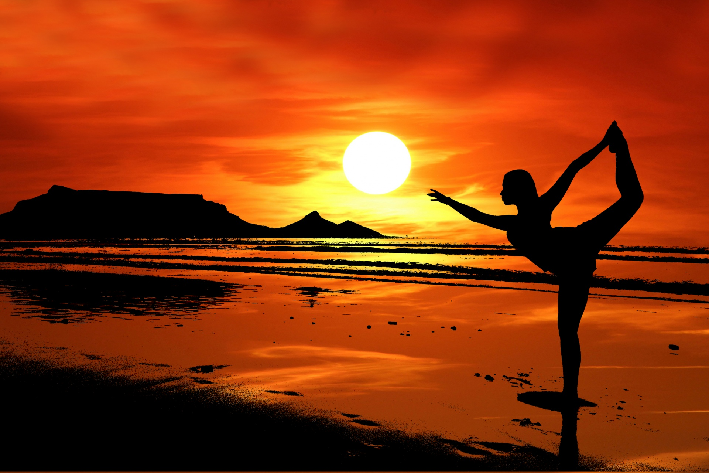
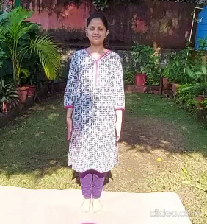
Asana Demonstration

Slide 8
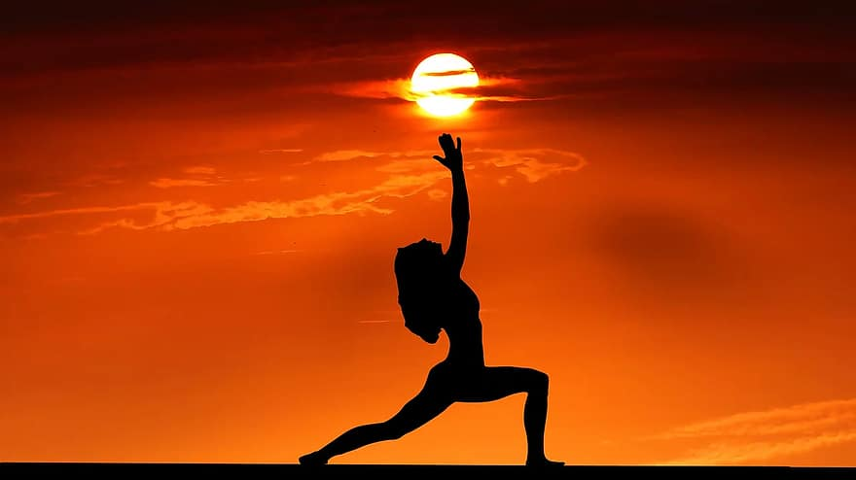
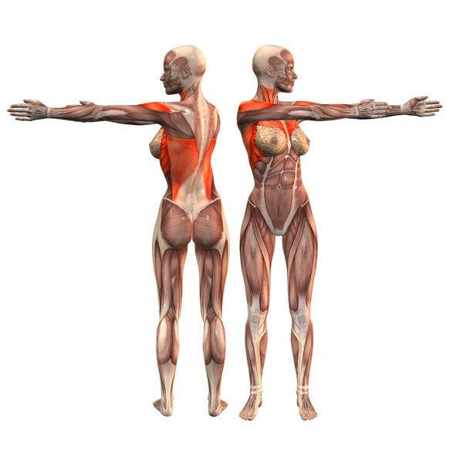
Biomechanical Analysis of Katichakrasana
Keeping the lower extremity fixed and perform a twisting motion of the lower trunk area and above.
30-35 degrees of axial rotation occurs to each side of the thoracic spine.
The orientation of the lumbar facet joint allows for more sagittal plane motion opposed to rotational horizontal plane motion.

Slide 9
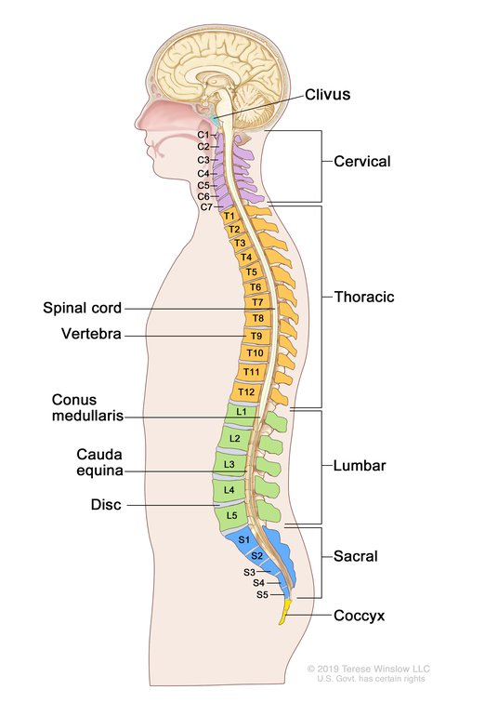
It may seem that we are rotating from lumbar spine but the rotation of the lumbar spine is limited to around 10 degrees.
The facets in the lumbar spine region protect the motion segment from anterior shear forces, excessive rotation and flexion.
The internal oblique abdominals and the external oblique abdominals are the muscles primarily responsible for powering spinal rotation in the lower back.
50% of rotation on cervical spine comes from C1-C2 joint which supports the skull as well as allows movements of skull and neck.

Slide 10

Psychological Benefits
Physical Benefits
Reduces Signs and Symptoms of Stress
Promotes the free-fall of Energy
Calms the Mind
Stimulates the Nervous System
Eases Depression
Restores the Depleted and Blocker Pronic Energy
Improves Blood Circulation
Improves Respiratory Indexes
Softens and Supple the Frozen shoulder
Improves the Flexibility of Waist and Spine

Slide 11
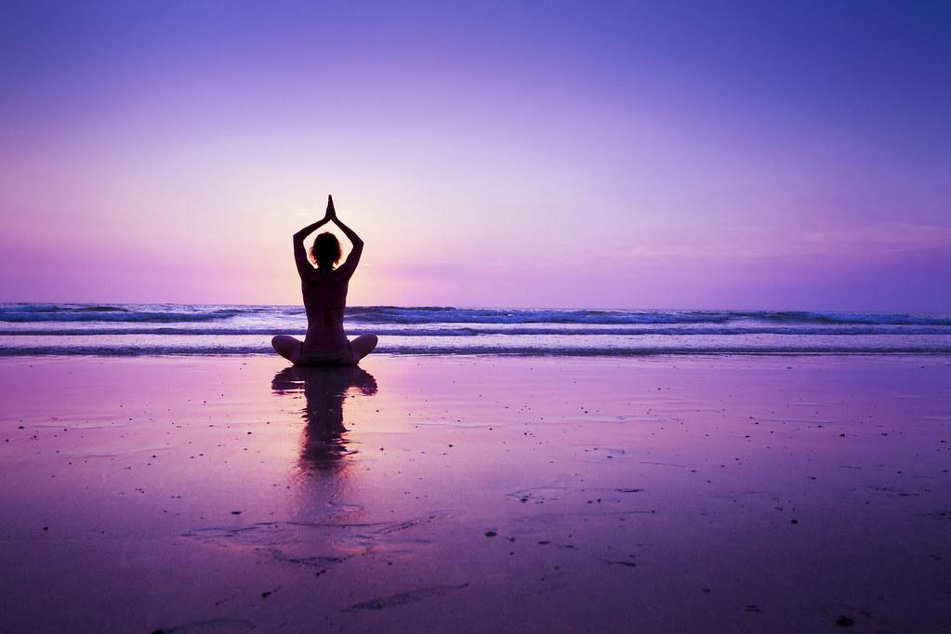
THANK YOU !!

